Slide 1

Introduction to
Computational Learning
Artificial Intelligence
School of Computing
Universiti Teknologi Malaysia

Slide 2
Machine Learning
How do we teach a machine to learn?

Slide 3
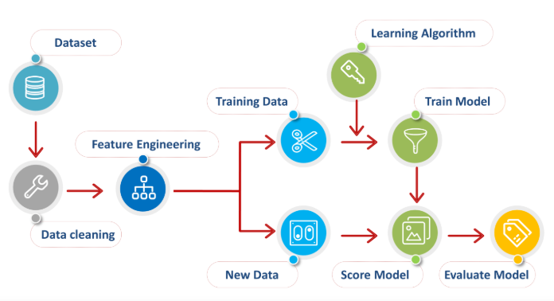
Machine Learning Process

Slide 4
How machine learns?
Machine learning utilizes techniques of understanding patterns from input data
Data is used for training by learning algorithm to learn and develop a specific computational model
Pre-processing involves extracting important features of data
Model refers to predefined prototype problem solver, produced based on patterns of input data

Slide 5
How good is the learning model?
The aim of a model is to be able to produce good results
Employ another set of data called testing data to evaluate the learning model
  Can be completely new
  Blinded dataset from the same resource
  Smaller part of training data previously separated

Slide 6
Learning types
Supervised learning
  The correct classes of the training data are known
Unsupervised learning
  The correct classes of the training data are NOT known
Reinforcement learning
  Machine learn its behavior based on feedback from environment

Slide 7
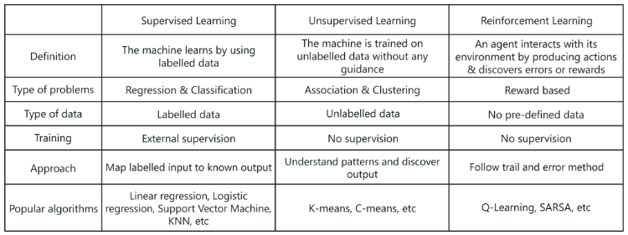
Learning types …

Slide 8
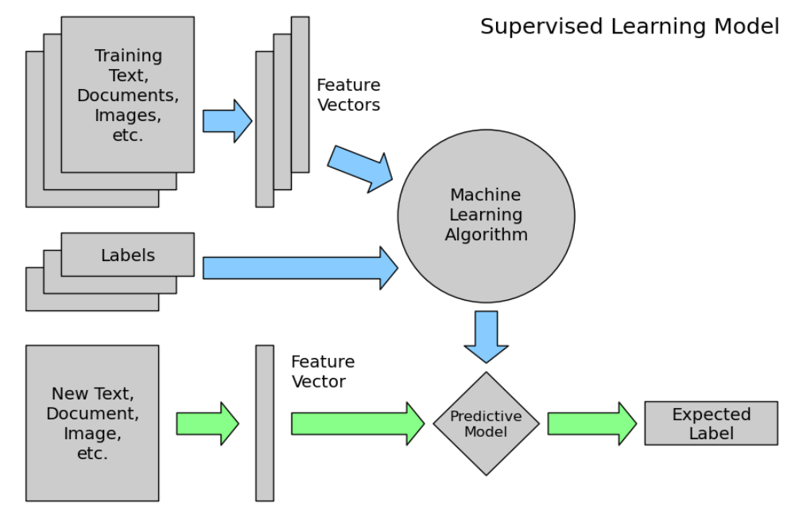
Supervised Learning

Slide 9
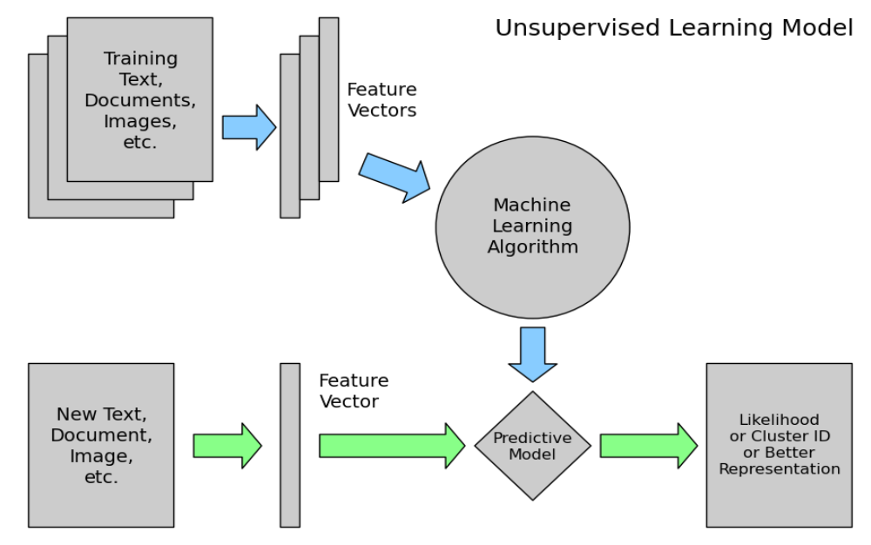
Unsupervised Learning

Slide 10
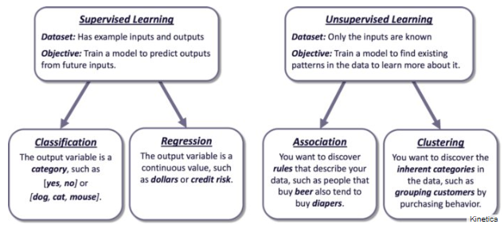
Supervised vs unsupervised

Slide 11
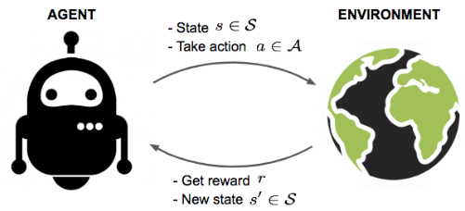
Reinforcement learning
An agent interacts with the environment trying to take smart actions to maximize cumulative rewards
The environment is formulated using Markov decision process to search for solutions

Slide 12
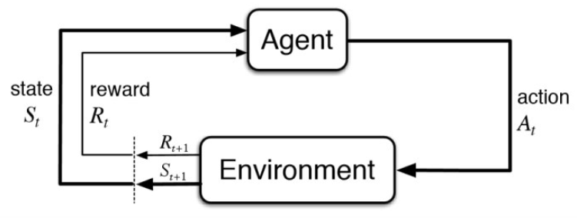
Markov Decision Process (MDP)
Feedback from the environment
Action that agent performs in environment
Current situation of the agent
Physical world in which the agent operates

Slide 13
Markov Decision Process (MDP)
The agent is acting in an environment
How the environment reacts to certain actions is defined by a model which we may or may not know
The agent can stay in one of the many states S of the environment and choose to take one of the many actions A so that it can switch from one state to another
Which state the agent will arrive is determined by transition probabilities P between states
Once an action is taken, a reward R is delivered by the environment as feedback

Slide 14
RL in real world
Games
  AlphaGo, AlphaGo Zero etc
Robotic
  (remember Spot from BostonDynamics?)
Traffic light control
Web system configuration
And many more

Slide 15
Machine learning techniques
Classification
  Predict class from observation
Clustering
  Group observations into ‘’meaningful” groups
Regression
  Predict value from observations

Slide 16
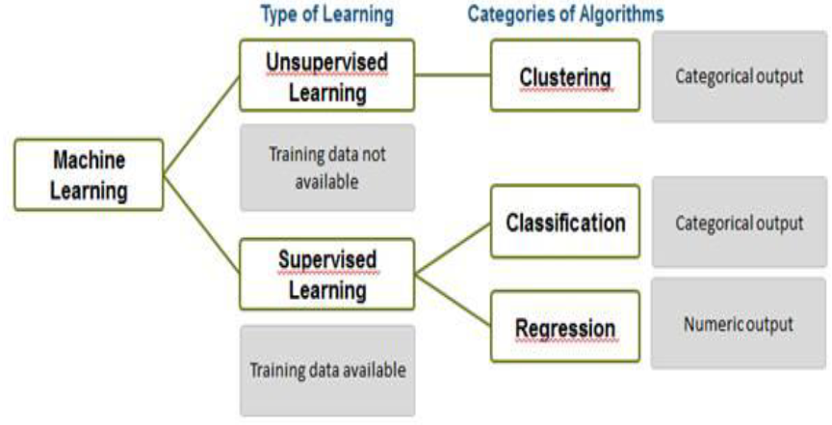
Classification and clustering

Slide 17
How real world use ML?
https://towardsdatascience.com/real-world-examples-of-applied-machine-learning-from-ai-conference-4d4678700c6
Real world examples
Uber COTA (Customer Obsession Ticket Assistant)
http://w4nderlu.st/assets/javascript/ViewerJS/#http://w4nderlu.st/content/3-publications/cota-improving-the-speed-and-accuracy-of-customer-support-through-ranking-and-deep-networks/cota-o-reilly-ai-conference-2018.pdf
AirBNB ; categorizing listing photos
https://medium.com/airbnb-engineering/categorizing-listing-photos-at-airbnb-f9483f3ab7e3
ZocDoc ; finding in network physicians from insurance cards
https://www.zocdoc.com/about/blog/tech/making-sense-of-insurance-cards-using-deep-learning/
Spotify ; How does it know your kind of music?
https://medium.com/s/story/spotifys-discover-weekly-how-machine-learning-finds-your-new-music-19a41ab76efe

Slide 18
Computational Intelligence
What methods machines use to learn?

Slide 19
Outline
What is AI?
Now, come Computational Intelligence (CI)
Scope of CI
Importance of CI
CI Techniques
  Artificial Neural Network
  Genetic Algorithm
  Fuzzy Logic

Slide 20
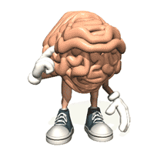
What is AI?
Ability to interact with the real world
Reasoning and Planning
Learning and Adaptation

Slide 21
Now, come Computational Intelligence (CI)
A methodology involving computing that exhibits an ability to learn and/or to deal with new situations, such that the system is perceived to possess one or more attributes of reason, such as generalization, discovery, association and abstraction (Russel et al, 1998).
CI is the field of computing that draws from the successes of natural systems to develop new ways of solving computational problems in the real world.

Slide 22
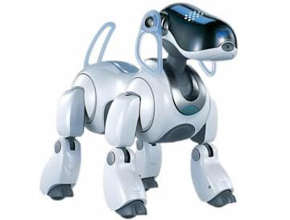
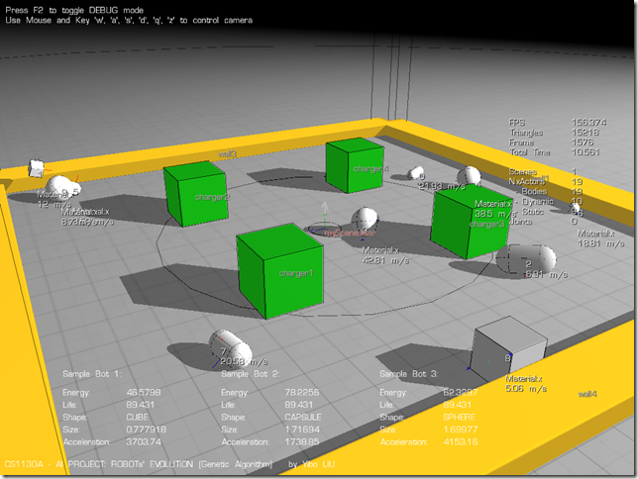
Scope of CI
practical adaptation concepts, paradigms, algorithms and implementations that enable or facilitate appropriate actions (intelligent behavior) in complex and changing environments.

Slide 23
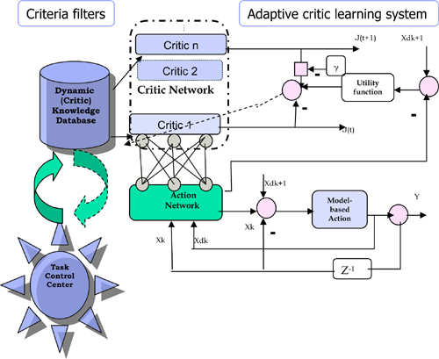
Scope of CI
Fuzzy, imprecise or imperfect data
No available mathematical algorithm
Optimal solution unknown
Rapid prototyping required
Only domain experts available
Robust system required
Learning capability
More recently:
DNA Computing
Quantum Computing

Slide 24
Importance of CI
Solve the problems in realistic situation ( not ideal) such as fuzzy, imperfect or incomplete, only domain experts available.
Complementary approaches with mathematical based algorithm solutions
Encourage new technology development especially in Quantum and DNA computing.

Slide 25
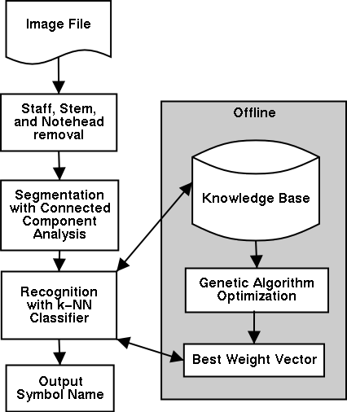
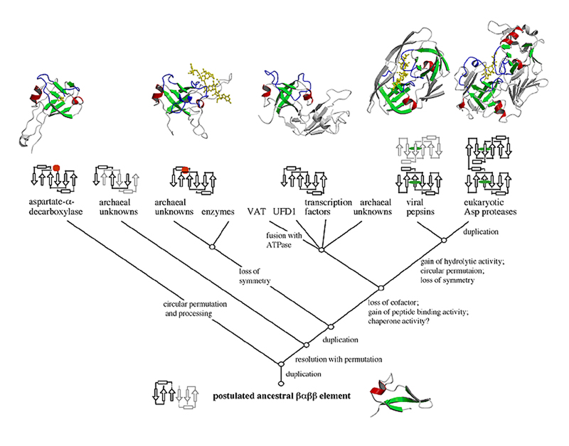
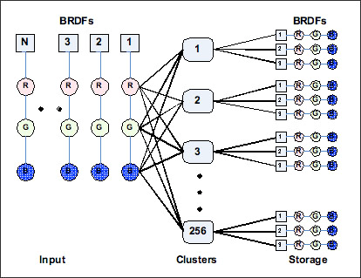
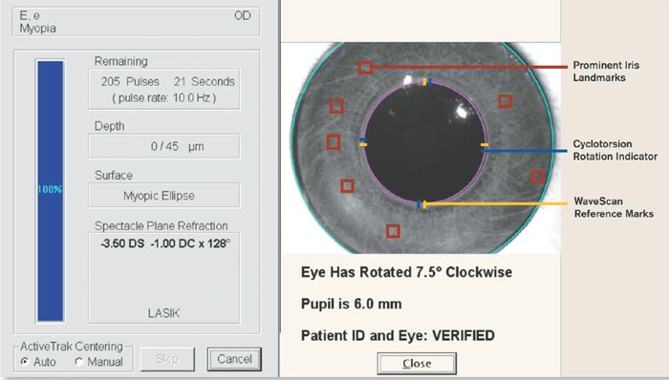
Importance of CI

Slide 26

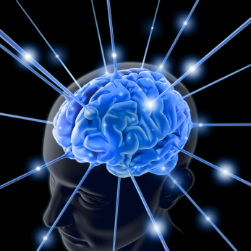
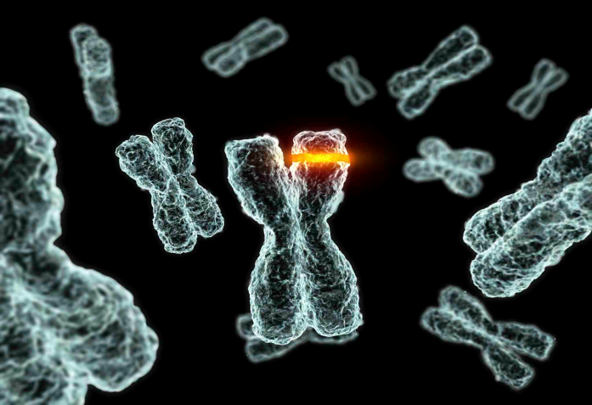
CI Techniques
Artificial Neural Network
Genetic Algorithm
Fuzzy Logic

Slide 27
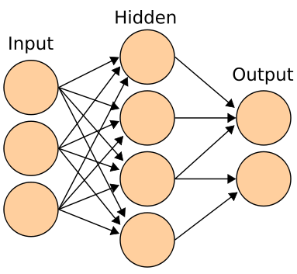
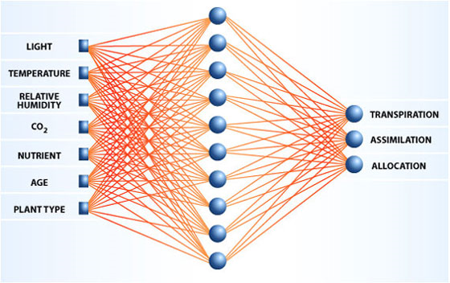
Artificial Neural Network

Slide 28
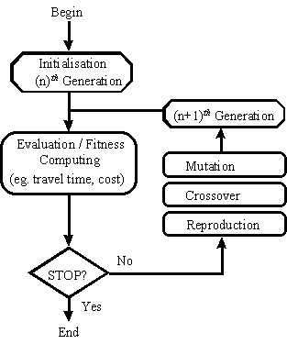
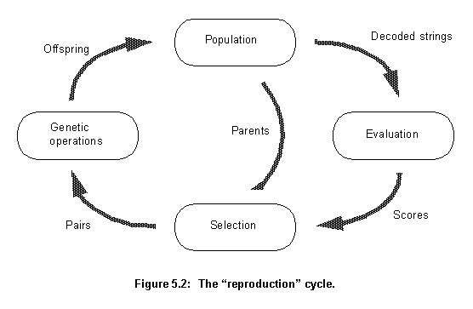

Genetic Algorithm

Slide 29
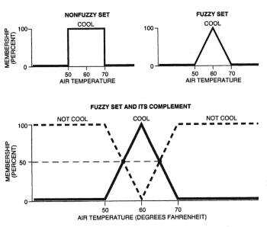
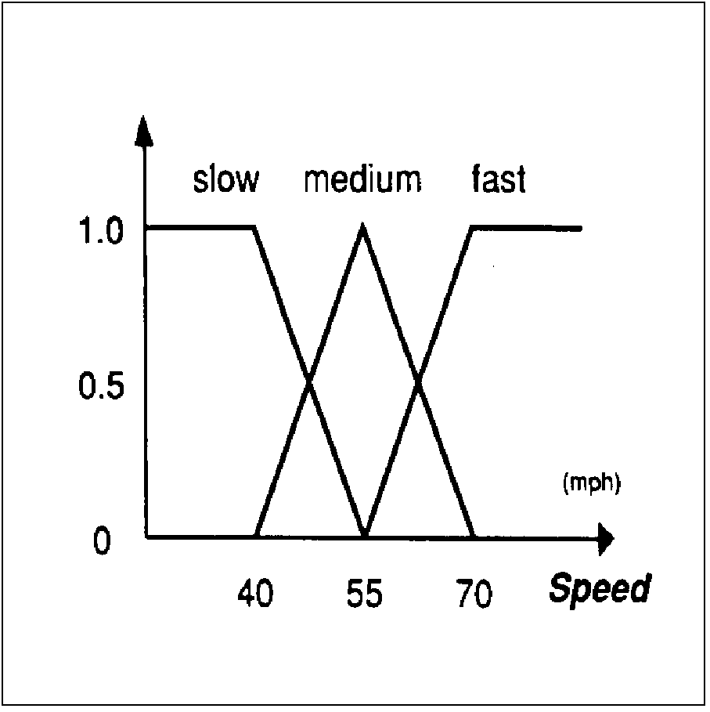
Fuzzy Logic

Slide 30
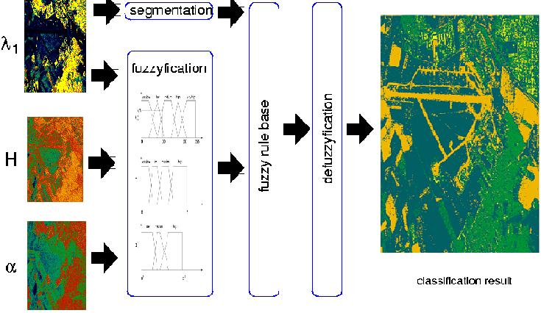
Fuzzy Logic

Slide 31

Q & A

